Slide 1

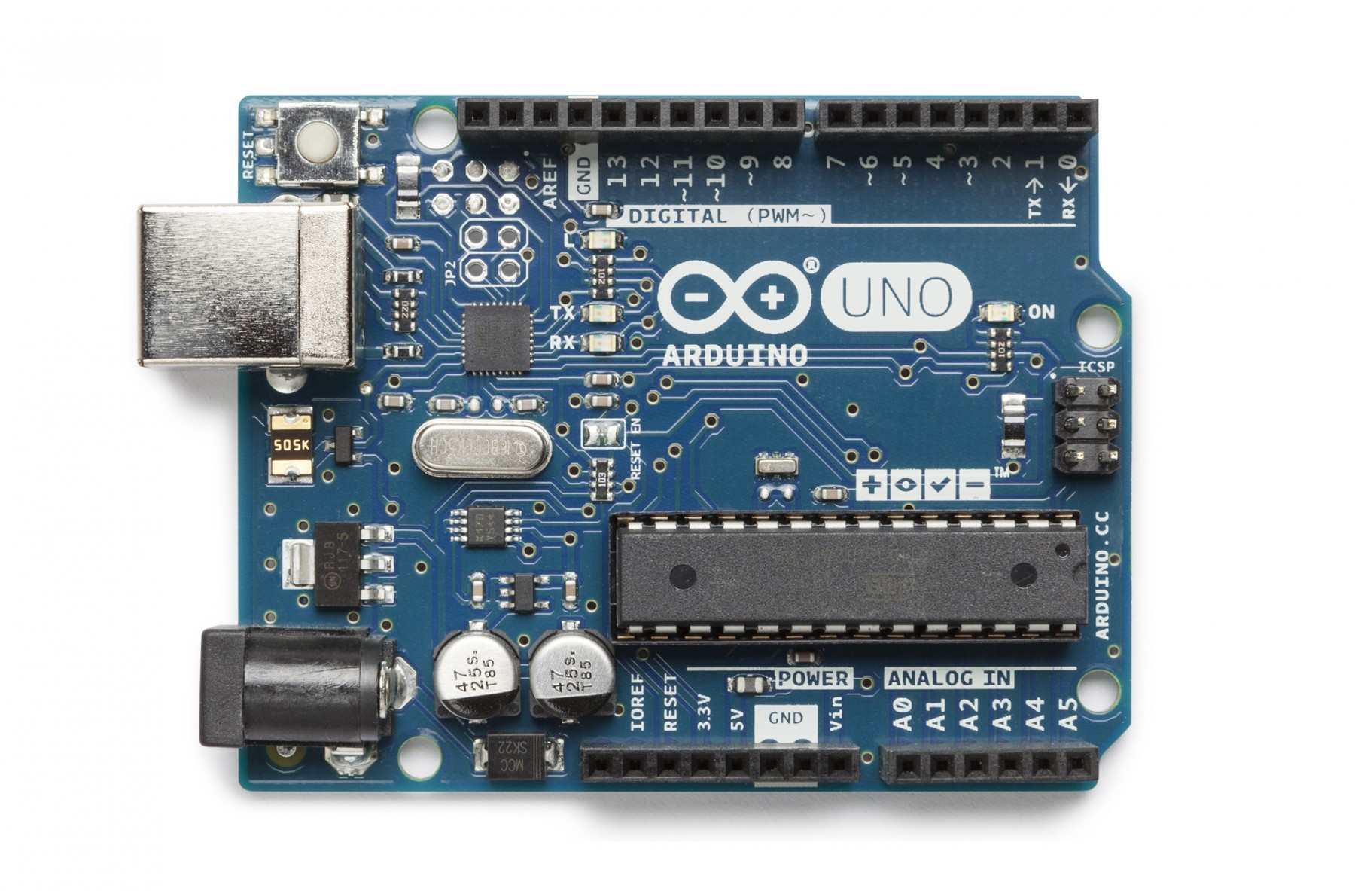
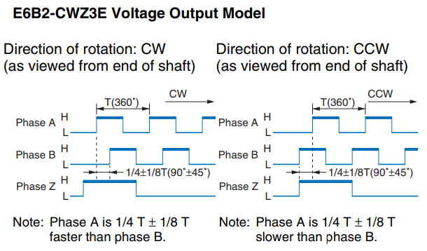
x
x
Pin 3 is Phase A Pin: Interrupts on CHANGED
Pin 2 is Phase B Pin: Interrupts on CHANGED
Orange wire is Phase Z: Not wired
Silver wire is Shielded (alternate GND): Not wired
Phase Changed | Phase A | Phase B | Direction
A | 0 | 0 | CCW
A | 0 | 1 | CW
A | 1 | 0 | CW
A | 1 | 1 | CCW
B | 0 | 0 | CW
B | 0 | 1 | CCW
B | 1 | 0 | CCW
B | 1 | 1 | CW

Slide 2
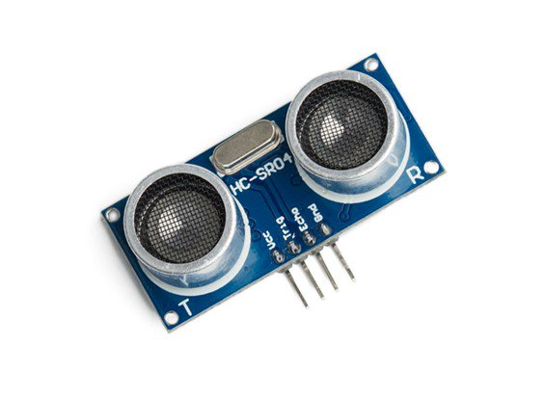
Pin 10 is Trigger Pin: Transmits 40 kHz signal
Pin 9 is Echo Pin: Receives 40 kHz signal

Slide 3
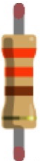

Slide 4
x
x

Slide 5
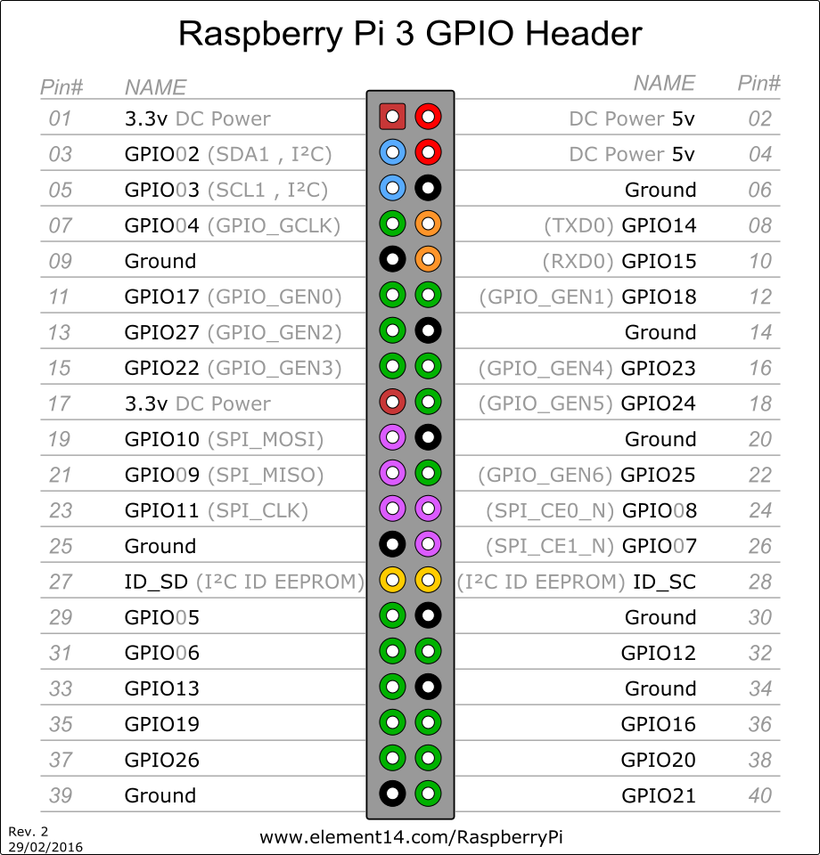
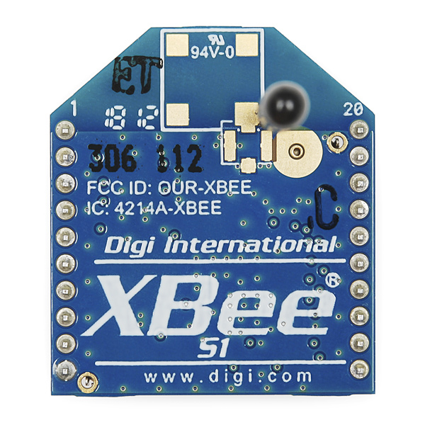
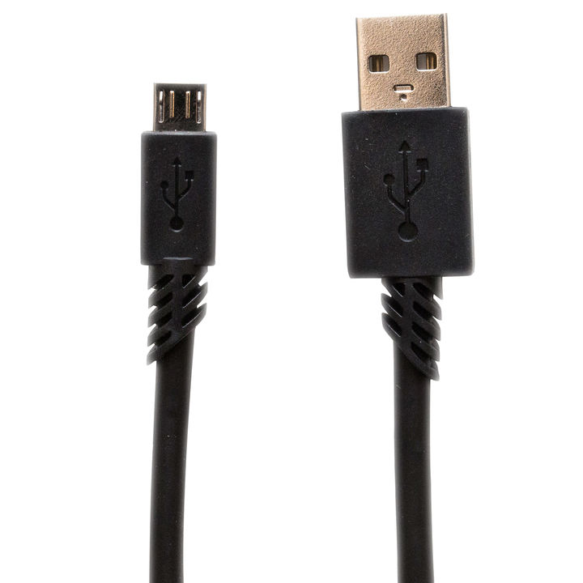
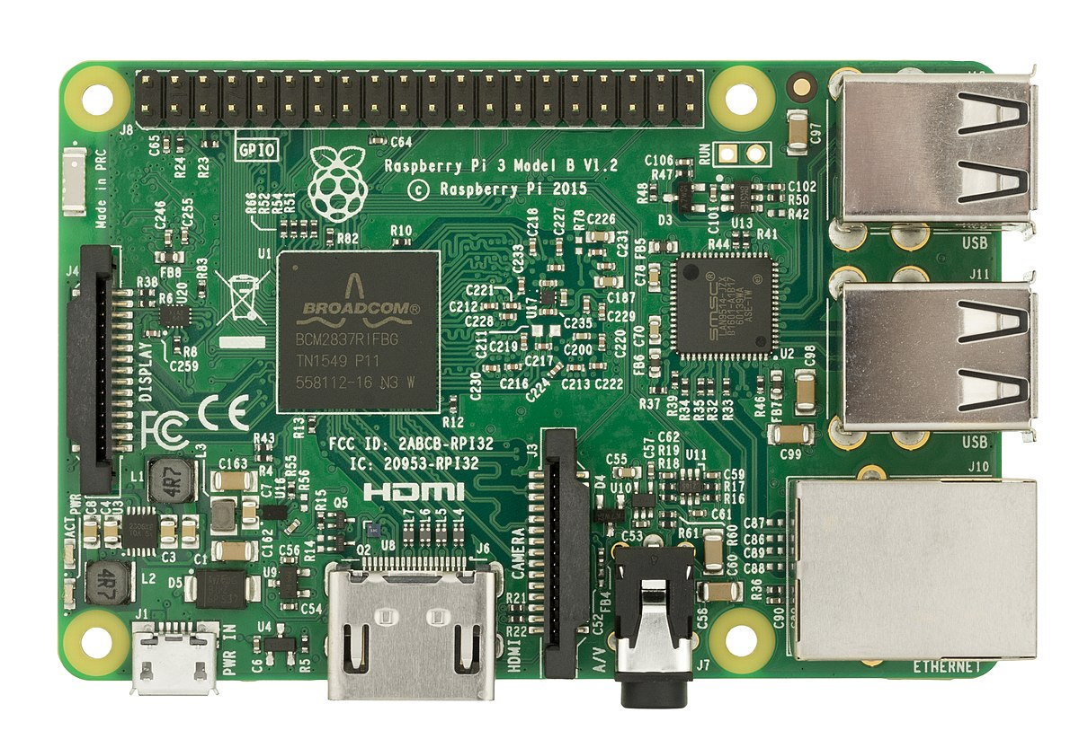
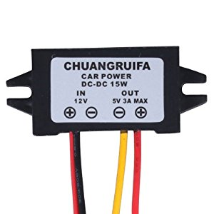
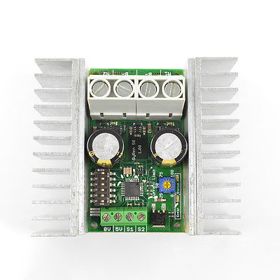
GPIO 14/RXD0: Serial Receive
Xbee Radio:
Send Address: 3333
My Address: 44<Platform Number> (e.g. 4401, 4402)
Baud: 38400
GPIO 15/TXD0: Serial Transmit
GPIO 5: Encoder 1 Phase A
GPIO 6: Encoder 1 Phase B
GPIO 20: Encoder 2 Phase A
GPIO 21: Encoder 2 Phase B
GPIO 16: Emergency Stop
(LOW == Stop)
Controller 1:
Packetized Serial, address 128
Baud: 38400
Controller 2:
Packetized Serial, address 135
Baud: 38400

Slide 6
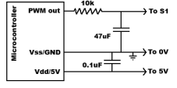
5V
0V/GND
PWM
DOUT
INTERRUPT A
INTERRUPT B

